Slide 1
Lesson 1: Getting Started

Slide 2
Microsoft PowerPoint 2016
Certification Guide – Lesson 7: Preparing the Slide Show

Slide 3
Lesson Objectives
review a presentation
insert and manage comments
edit and reply to comments
delete comments
compare presentations
customize a presentation
add speaker notes
create handouts
embed fonts
proof a presentation
ensure a presentation is accessible and compatible
set up a slide show
use presentation tools
use presenter view
rehearse a presentation
customize rehearsed timings
record a presentation
create custom slideshows
present online

Slide 4
Inserting Comments
To viewing comments, on the Review tab, in the Comments group, click Show Comments, and click Show Markup
To insert comments:
  on the Review tab, in the Comments group, click New Comment or
  on Status Bar, click Comments
To change the user name, click File, click Options, and in the General section, click the Always use these values regardless of sign in to Office
Notes:
190-
5.1.3,

Slide 5
Managing Comments
You can create new comments, reply to or forward a comment, edit an existing comment, as well as delete a comment
  Use the Comment pane for the comment, or click the appropriate option in the Comments group of the Review tab
  Use the Next or Previous buttons to move between comments
PowerPoint displays a to show there is a comment
Notes:
191

Slide 6

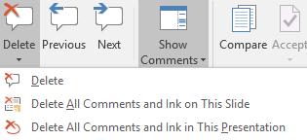
Editing and Replying to Comments
Select comment to open, type in comment
To reply, type in the reply area
  Press TAB or click away to finish
To delete a comment:
  In the Comments Pane, click
  right-click the comment icon and click Delete comment
  on the Review tab, in the Comments group, click Delete Comment
    Click drop down arrow for other selections
Notes:
191-192
5.1.4

Slide 7
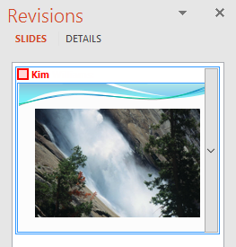
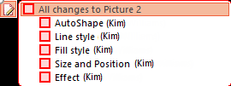
Comparing Presentations
Find and review the differences between two versions of a presentation
To compare a presentation, display the first presentation, and then on the Review tab, in the Compare group, click Compare
  Open the second version of the presentation and click Merge
Review changes then select check boxes
  Click Accept or Reject from the Compare group on the Review
  tab
    You can choose to Accept All Changes to Current Slide or Presentation,
    or Reject All Changes to Current Slide or Presentation
    When complete, click End Review
Notes:
192-194
5.1.2

Slide 8
Customizing – adding Speaker Notes
Click the View tab, and in the Presentation Views, click Notes Page
To set up set up how the Notes Page will look, on the View tab, in the Master Views group, click Notes Master
To enter notes on the Slide Pane, click in the Notes Pane area and type the text directly into this location
  If not displayed, click Notes on the status bar to display the pane
  Use the split bar to increase or decrease size of the Notes Pane
To print the notes, click File, click Print, in the Print Layout area, click Notes Pages
Notes:
195-197
1.3.6, 1.5.2, 1.6.2

Slide 9
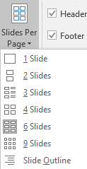
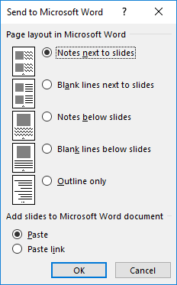
Creating Handouts
To set up how handouts will appear when printed, on the View tab, in the Master Views group, click Handout Master
To print handouts, click File, click the arrow for Full Page Slides,
click Handouts, and then select the layout
  Can also choose to print handouts in Word
    Click File, click Export, click Create Handouts, click
    Create Handouts, and then click the layout option in
    the Send to Microsoft Word dialog box
Notes:
197-199
1.3.5, 1.6.3, 5.2.5

Slide 10
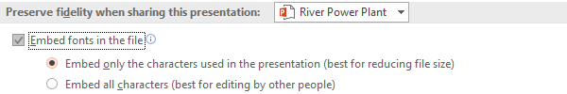
Embedding Fonts
When using a non-standard font in presentation, consider embedding fonts so others can view the presentation as it was meant to be viewed
To embed fonts in a presentation:
  Click File, click Save As, and in the Save As window, click Tools, click Save Options, and check Embed Fonts in the file; or
  Click File, click Options, click the Save option, and in Preserve fidelity area, click Embed fonts in the file
Notes:
199-200
5.2.4

Slide 11
Proofing a Presentation
    After running the Spelling and Grammar Checker, manually check your entire presentation
      Have someone else review
      Read text backwards
      Read text out loud
      Double-check homonymns: they’re, their, there, or to, too and two
      Double-check apostrophe and comma usage
      Proofread a printed presentation outline
      Check flow and logic
      Check for consistent elements – ABC Corporation vs. ABC Corp.
      Use Slide Master and Format Painter to ensure consistency
      Verify sizing of objects
Notes:
201-202
5.2.3

Slide 12
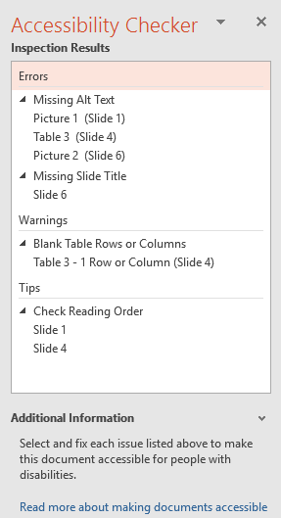
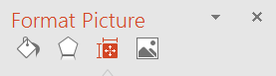
Using the Accessibility Checker
Click File, in the Info tab, in the Inspect Presentation area, click Check for Issues and click Check Accessibility
  Issues are reported in the pane such as missing Alt text
  Alt Text (Alternative Text) is read aloud by screen readers for
  visually impaired
    In the Format Picture pane, click the Size & Properties icon and then
    click Alt Text; or
Notes:
202-203
5.2.2

Slide 13
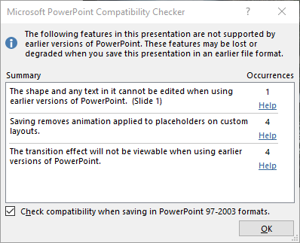
Using the Compatibility Checker
Click File, in the Info tab, in the Inspect Presentation area, click Check for Issues, and then click Check Compatibility
  If you frequently save using the PowerPoint 97-2003 format, select Check compatibility when saving in PowerPoint 97-2003 formats
Notes:
203-204
5.2.2

Slide 14
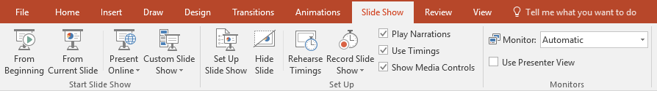
Running the Slide Show
To view your presentation:
  click the Slide Show tab, in the Start Slide Show group, click From Beginning or From Current Slide; or
  on the Status bar, click the button; or
  press F5 to view from first slide, or press SHIFT+F5 to view from the current slide; or
  press ALT+ to open a slide show window in PowerPoint
You can hide slides from the Slide Sorter view, the Slides thumbnail pane, or from within the slide show
Notes:
204-206
1.5.2, 1.7.2

Slide 15
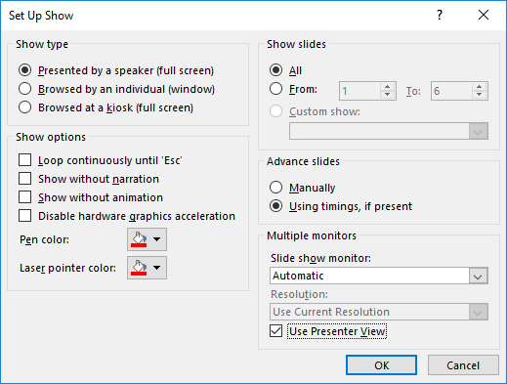
Setting Up a Slide Show
To set up how a slide show displays:
  click the Slide Show tab, in the Set Up group,
  click Set Up Slide Show; or
  press SHIFT+
Three types of preset shows that you can select
based on how the audience will view the
presentation, such as a live audience
You can also manually select options to your
preference when the presentation is viewed
Notes:
206-207
1.5.2, 1.7.2

Slide 16
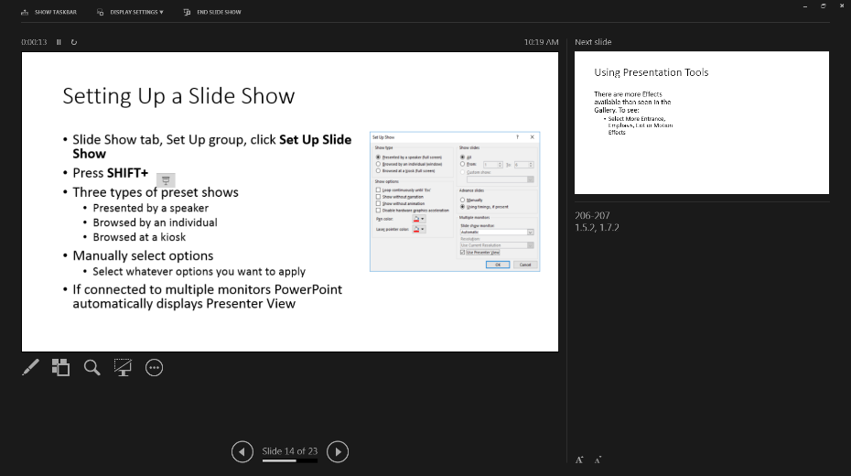
Setting Up a Slide Show
Use the Presenter View when you may be presenting to a live audience and you will connect to another monitor type
  PowerPoint automatically displays Presenter View
    Use same options as if viewing slide show on
    your own screen, such as navigating to specific
    slides, or activating the pen
    Displays preview of next slide
    Displays speaker notes for reference
Notes:
206-207
1.5.2, 1.7.2

Slide 17
Using Presentation Tools
On screen presentation tools appear when not using Presenter View and you point at them
  right-click to show more options
Notes:
207-208
1.7.4

Slide 18
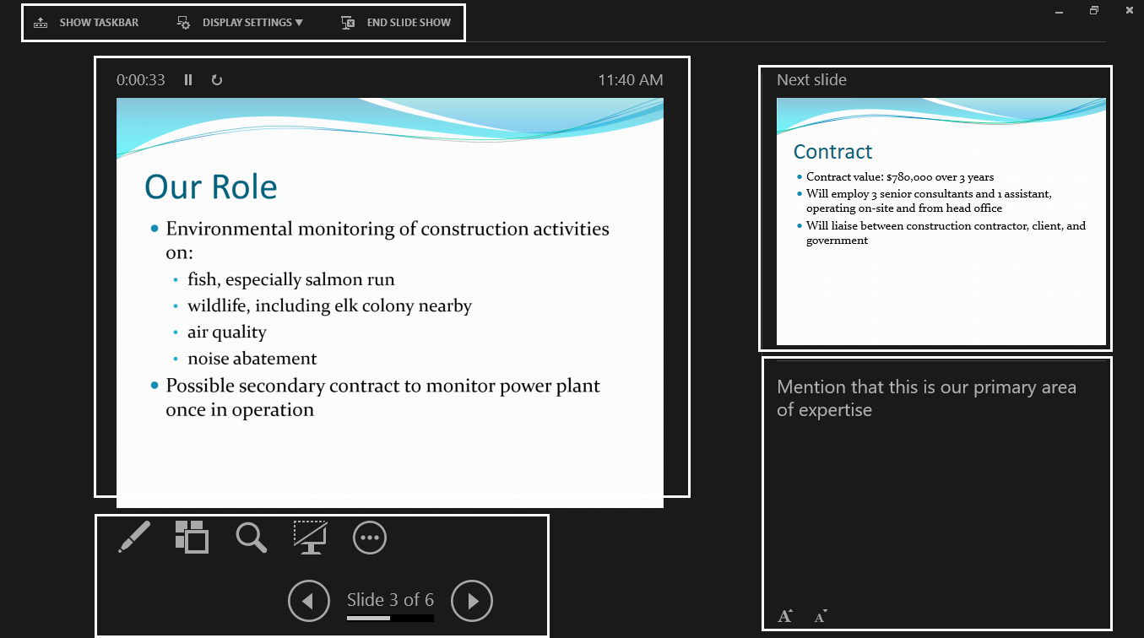
Using Presenter View
To turn on the Presenter View:
  On the Slide Show tab, in the Monitors group, click Use Presenter View; or
  press ALT+F5; or
  within the Slide Show view, click More Options and then click Show Presenter View; or
  right-click the screen and click Show Presenter View
Toolbar
Slide Preview
Slide Thumbnail
Presenter and Navigation Tools
Notes Pane
Notes:
209-210
1.7.4

Slide 19

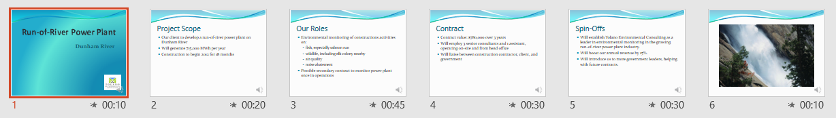
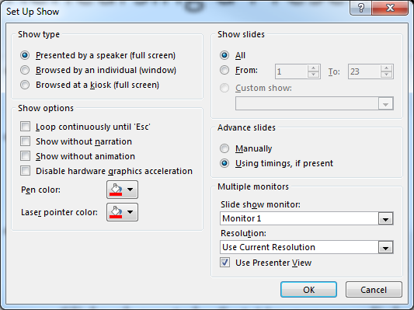
Rehearsing a Presentation
On the Slide Show tab, in the Set Up group, click Rehearse Timings
Timings are indicated on each slide in Slide
Sorter View or under Duration in Normal
View
To run the slide show with timings:
  on the Slide Show tab, in the Set Up group, click Use
  Timings; or
  on the Slide show tab, in the Set Up group, click Set Up
  Slide Show and click Using timings, if present
Next
Pause
Repeat
Notes:
211-212
1.7.3

Slide 20
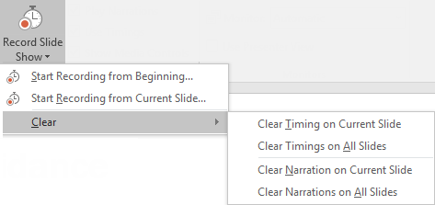
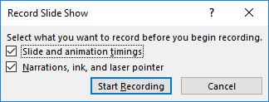
Recording a Presentation
On the Slide Show tab, in the Set Up group, click Record Slide Show, select Start Recording from Beginning or Start Recording from Current Slide
  Select what you will record
  Sound icon appears on slide
To clear the recording, on the Record Slide
Show menu, select clear option
Notes:
213
1.7.3

Slide 21
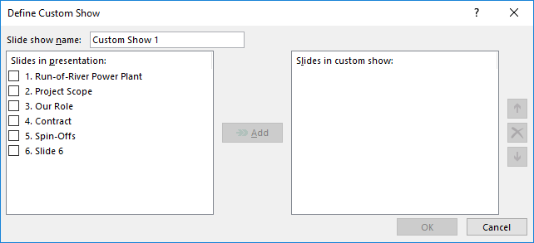
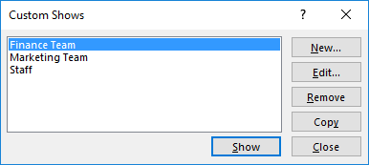
Creating Custom Slideshows
On the Slide Show tab, in the Start Slide Show group, click Custom Slide Show, click Custom Shows, and click New
  Enter a name the new slide show, and then
  select the slides to be added to the new show
  Use the side arrows or “x” to arrange or delete
  added slides
To play the new show, click Custom Slide Show and
select the name of the slide show
To manage custom slide shows, click Custom Slide
Show for options to appear
Notes:
214-215
1.7.1

Slide 22
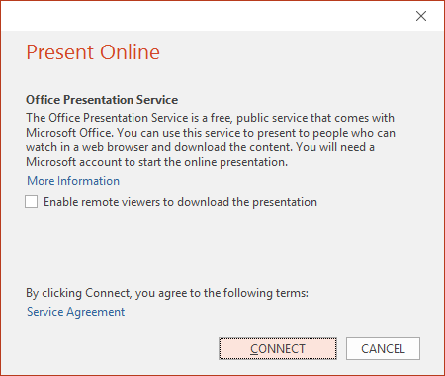
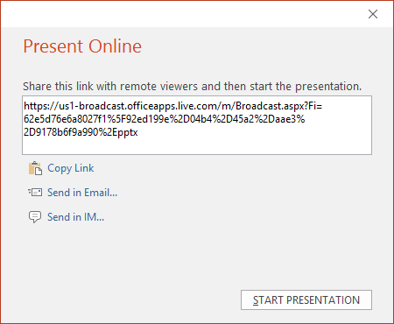
Presenting Online
You will need a Microsoft account to start an online presentation
  On the Slide Show tab, in the Start Slide Show group, click Present Online; or
  click File, click Share, click Present Online, and click Present Online
To make the show available for download, click Enable remote viewers to download the presentation
Notes:
216-217

Slide 23
Lesson Summary
review a presentation
insert and manage comments
edit and reply to comments
delete comments
compare presentations
customize a presentation
add speaker notes
create handouts
embed fonts
proof a presentation
ensure a presentation is accessible and compatible
set up a slide show
use presentation tools
use presenter view
rehearse a presentation
customize rehearsed timings
record a presentation
create custom slideshows
present online

